Slide 1
Learning Terraform (Basic)
Adedeji Awolesi
Cloud Platform Engineer (Devops)

Slide 2
Infrastructure as a Code
What Iaac?
Manual work is difficult.
Manual work is error prone.
Manual work is slow.
Benefits
Code is repeatable.
It’s easy to work together.
Faster. (After you’ve learned the tools)
Code can have a version.
Modules (or units) can be tested.
Easy to test on a non-production environment.
Easy to learn by reading, less documentation.
And More

Slide 3
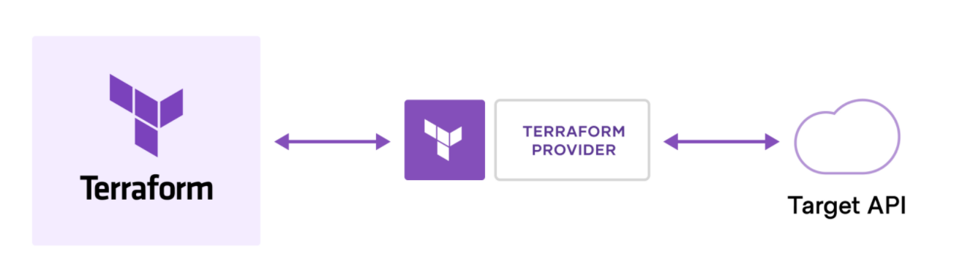
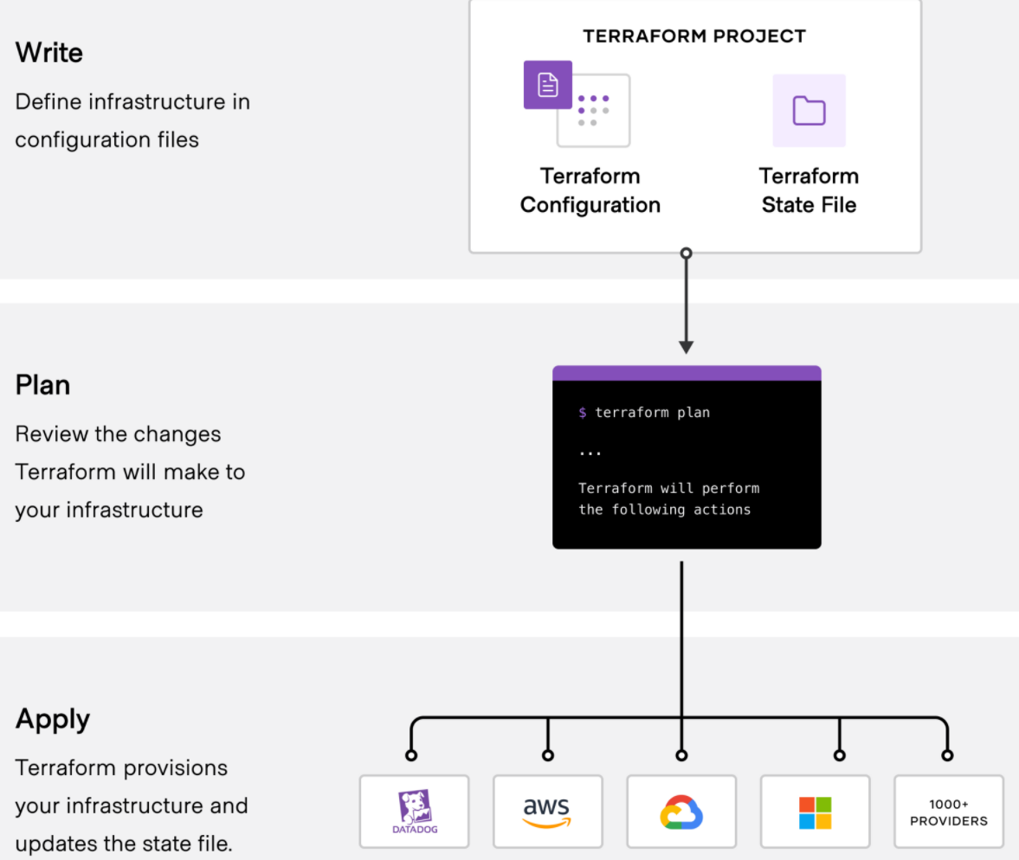
Terraform
HashiCorp Terraform is an infrastructure as code tool that lets you define both cloud and on-prem resources in human-readable configuration files that you can version, reuse, and share.
Terraform creates and manages resources on cloud platforms and other services through their application programming interfaces (APIs).
Has more than 1700 providers and more
3 Stages of Terraform
Write
Plan
Apply
LEARN: AWS,AZURE,GCP
Video from Harshicorp
Video from IBM
Source: https://www.terraform.io/intro

Slide 4
Install Terraform
AWS
AZURE
GCP
Verify : terraform –version
To manage Azure infrastructure, you also need azure-cli. Follow this guide for Windows computers.
NOTE: You need an Azure Subscription and create a new account.
Setup GIT for Version Control (Learn GIT)
Setup Visual Studio Code ( Add extension and Install the plugins “HashiCorp Terraform” and “Azure Terraform)

Slide 5
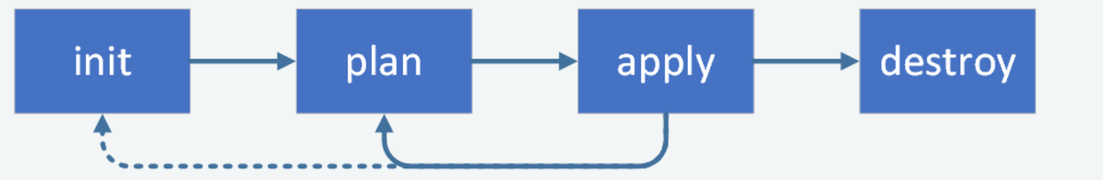
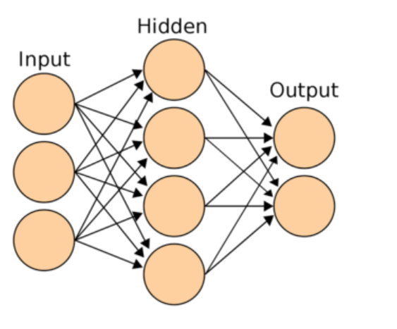
Terraform workflow
Variables: Are details that are required to build your infrastructure. E.g The amount of machines required, name of machine and size of instance etc
Terraform allows use of multiple .tf files.
Strings
List
Map values
Output
For each
Count
Modules

Slide 6
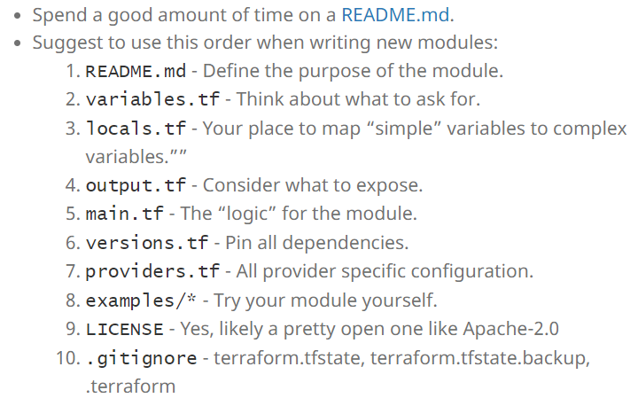
Practicals
Advanced
Terraform Cloud (workspace etc)
CI/CD
Data objects
Functions
Locals
Best Practices

Slide 7

Thank you

